Slide 1
➡️ How to use this Template
The Problem Management Strategy Blueprint Template is designed to provide organisations with a structured approach to enhancing their Problem Management Process. This comprehensive template helps identify key drivers, benefits, advantages, and ensures alignment with organisational objectives while addressing potential risks. It serves as a foundational tool for IT and management teams to develop and implement effective problem management strategies that support the overall goals of the organisation.
Each section is designed for you to develop purposeful content to convey key messages and points to sponsors and teams in a simple format to gain credibility and support for the Problem Management Uplift initiative.
Instructions: Update each section of the Problem Management Strategic Blueprint to your specific needs. It’s important to ensure the Problem Management Strategy:
is ‘fit for purpose’ for your organisation.
resonates with your sponsors and teams.
Serves as a strategic guide for your Problem Management uplift Initiative.
Text in black provides the overall content structure to the Problem Management Strategy
Text and boxes in blue outlines where to include content specific to your Problem Management Strategy
Text in red provides you with optional inclusions, these can be updated/modified to meet your specific Problem Management Strategy requirements.
*Important note: Remove this slide from your final version before presenting and sharing the Problem Management Strategy Blueprint
This template has been provided for use to the purchaser of the SMS Problem Management Uplift program. ©SMS 2024 Service Management Specialists PTY LTD, this material cannot be reproduced without authorisation from Service Management Specialists PTY Ltd.

Slide 2


Problem Management | Uplift Strategy
<Date>:
<Name>:
<Role>:
<Company Logo>

Slide 3
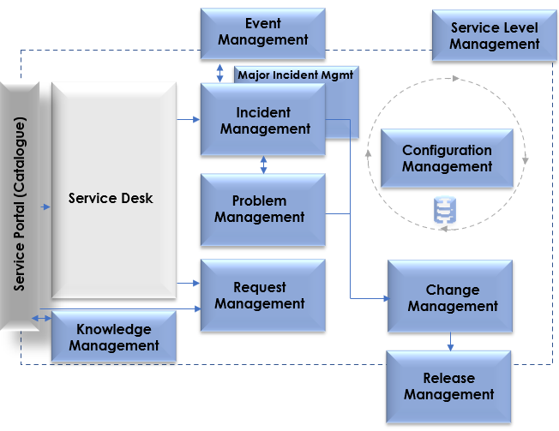
What is Problem Management?
It’s an ITSM Practice that focuses on: Identifying and resolving the root causes of recurring incidents and problems in an organisations IT Infrastructure and IT Services
Mechanism for getting to the ‘Root Cause’ of issues
Mechanism for identifying:
  Themes that are restricting the performance of operations
  Optimisation opportunities
Typical ITSM Controls
<Company Logo>

Slide 4
Why is Problem Management Important?
Provides a formal way for identifying Root Causes
Supports a formal way to identify, review and ascertain overall operational performance
Provides a formal way for ‘Preventing Recurring Incidents’ and ‘Fixing Root Cause’ as required.
Improves Service Reliability
Reduces Cost on workarounds and fixes that do not work
Supports other Key ITSM Controls eg: Incident, Change, Release, Configuration Management
Improves customer satisfaction & Supports a ‘Continuous Improvement Culture’
Reduces downtime and disruptions
Decreases Problem resolution time
Increases productivity
Improves customer satisfaction
<Company Logo>

Slide 5
What is driving the need for Problem Management?
<enter need here>
<enter need here>
Reduce Recurring Incidents: Fix issues so they don't keep happening.
Enhance Service Quality and Reliability: Ensure services are consistently reliable and high-quality.
Increase Efficiency and Productivity: Resolve problems faster and use resources better.
Mitigate Risk and Compliance Issues: Manage risks and comply with regulations.
Support Business Growth and Innovation: Handle new challenges as the business grows.
Customer Satisfaction: Improve customer satisfaction by reducing downtime and providing faster, more reliable service.
Cost Reduction: Lower operational costs by minimising the impact and frequency of problems.
Data-Driven Decision Making: Utilise insights from problem management data to make informed decisions and improve overall strategy.
Employee Morale: Enhance employee morale by reducing frustration with recurring issues and inefficient processes.
Competitive Advantage: Gain a competitive edge by demonstrating superior service reliability and problem resolution capabilities.
<Company Logo>

Slide 6
What are the benefits & advantages of Problem Management?
<enter benefits & advantages here>
<enter benefits & advantages here>
Reduce Downtime: Minimise service interruptions.
Improve Service Quality: Deliver consistently reliable and high-quality services.
Faster Issue Resolution: Speed up the process of fixing problems.
Cost Savings: Lower costs by preventing recurring issues.
Better Resource Utilization: Use staff and resources more effectively.
Enhanced Customer Satisfaction: Increase customer happiness by providing reliable services.
Risk Mitigation: Identify and address potential risks early.
Regulatory Compliance: Ensure adherence to industry regulations.
Data-Driven Insights: Use problem data to make informed decisions.
Increased Employee Morale: Boost staff satisfaction by reducing repetitive problems and improving workflows.
<Company Logo>

Slide 7
How does Problem Management Align with our Organisational Objectives?
<enter organisational objectives here>
<enter Problem Management uplift outcomes here>
Strategic Objective: Improve Customer Satisfaction
Strategic Objective: Increase Operational Efficiency
Strategic Objective: Reduce Operational Costs
Strategic Objective: Foster Innovation and Growth
Strategic Objective: Ensure Regulatory Compliance and Risk Management
Aligned Outcome: Enhanced Service Reliability - Reducing downtime and resolving issues more quickly leads to higher service reliability, directly improving customer satisfaction.
Aligned Outcome: Streamlined Problem Resolution - By optimising Problem Management processes, the organisation can resolve issues faster and more efficiently, increasing overall operational efficiency.
Aligned Outcome: Cost Savings from Fewer Recurring Issues - Effective Problem Management reduces the frequency of recurring problems, leading to significant cost savings.
Aligned Outcome: Support for Business Innovation - A robust Problem Management framework allows the organisation to better manage and resolve complex issues, supporting ongoing innovation and growth.
Aligned Outcome: Improved Risk Mitigation - By identifying and addressing potential risks early, Problem Management helps the organisation stay compliant with regulations and effectively manage operational risks.
<Company Logo>

Slide 8
The Risks of not undertaking a Problem Management uplift initiative:
<enter risks of not undertaking a Problem Management uplift initiative here>
Increased Downtime: More frequent and prolonged service interruptions.
Higher Operational Costs: Rising costs due to repeated issues and inefficient problem resolution.
Reduced Customer Satisfaction: Decline in customer trust and satisfaction due to unreliable services.
Decreased Productivity: Employees spend more time dealing with recurring issues instead of focusing on strategic tasks.
Regulatory Non-Compliance: Increased risk of failing to meet industry regulations and standards.
Poor Decision Making: Lack of data and insights from problem management hampers informed decision-making.
Negative Impact on Reputation: Damage to the organization's reputation due to ongoing service problems.
Increased Risk Exposure: Greater vulnerability to operational and security risks.
Low Employee Morale: Frustration among staff due to persistent issues and ineffective problem resolution processes.
Lost Competitive Advantage: Falling behind competitors who have more reliable and efficient problem management processes.
<Company Logo>

